Slide 1
Monitors & Conditional Synchronisation
Concurrent Programming CT074-3-2 Version 0120

Slide 2
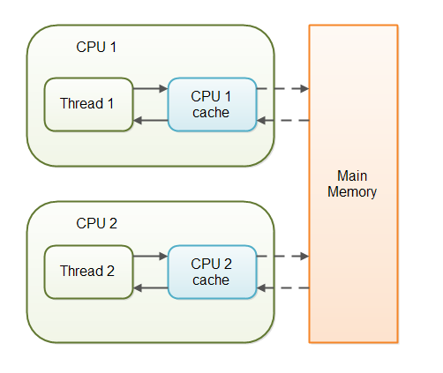
volatile

Slide 3
Add Thread C with Normal priority to Priority.java

Slide 4

Workshop Workers

Slide 5
Topic & Structure of The Lesson
Monitors
Conditional Synchronisation

Slide 6
Learning Outcomes
At the end of this topic, You should be able to
Describe Monitors
Implement Conditional Synchronisation

Slide 7
Key Terms You Must Be Able To Use
If you have mastered this topic, you should be able to use the following terms correctly in your assignments and exams:
Monitors
Conditional Synchronisation

Slide 8
Monitors & Conditional Synchronization
Concepts: monitors:
encapsulated data + access procedures
mutual exclusion + condition synchronization
single access procedure active in the monitor
nested monitors
Practice: private data and synchronized methods (exclusion).
wait(), notify() and notifyAll() for condition synch.
single thread active in the monitor at a time

Slide 9
Learning Outcomes
At the end of this module, you should be able to do the following:
Explain and apply the fundamental concepts of concurrency in the design and construction of a concurrent system using Java application.
Discuss the safety aspects of multi threaded system
Discuss the need for encapsulation in concurrent systems

Slide 10
Learning Outcomes
At the end of this module, you should be able to do the following:
Discuss the concept of condition synchronisation.
Represent condition synchronisation in Java.

Slide 11
Condition Synchronization
Monitors are language features for concurrent programming.
A monitor encapsulates data which can only be observed and modified by monitor access procedures.
Monitors support conditional synchronisation in addition to ensuring that access to the data they encapsulate is mutually exclusive.

Slide 12
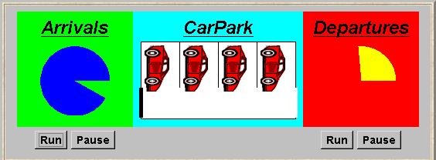
Condition Synchronization
A controller is required for a carpark, which only permits cars to enter when the carpark is not full and does not permit cars to leave when there are no cars in the carpark. Car arrival and departure are simulated by separate threads.

Slide 13
What is the most noticeable difference between the Carpark problem and the Ornamental Garden problem?
Notes:
Cars can actually leave the car park. There is arrival and departure, instead of just arrival. Also there is limited parking space. Therefore, some form of control needed to control arrival and departure actions.

Slide 14
Carpark model
Events or actions of interest?
arrive and depart
Identify processes.
arrivals, departures and carpark control

Slide 15
Ornamental garden Program - class diagram
The Turnstile thread simulates the periodic arrival of a visitor to the garden every second by sleeping for a second and then invoking the increment() method of the counter object.

Slide 16
carpark program - class diagram
We have omitted DisplayThread and GraphicCanvas threads managed by ThreadPanel.

Slide 17
carpark program
Arrivals and Departures implement Runnable, CarParkControl provides the control (condition synchronization).
Instances of these are created by the start() method of the CarPark applet :
public void start() {
CarParkControl c =
new DisplayCarPark(carDisplay,Places);
arrivals.start(new Arrivals(c));
departures.start(new Departures(c));
}

Slide 18
carpark program - Arrivals and Departures threads
class Arrivals implements Runnable {
CarParkControl carpark;
Arrivals(CarParkControl c) {carpark = c;}
public void run() {
try {
while(true) {
ThreadPanel.rotate(330);
carpark.arrive();
ThreadPanel.rotate(30);
}
} catch (InterruptedException e){}
}
}
Similarly Departures which calls carpark.depart().
How do we implement the control of CarParkControl?

Slide 19
Carpark program - CarParkControl monitor
class CarParkControl {
protected int spaces;
protected int capacity;
CarParkControl(int n)
{capacity = spaces = n;}
synchronized void arrive() {
… --spaces; …
}
synchronized void depart() {
… ++spaces; …
}
}
mutual exclusion by synch methods
condition synchronization?
block if full? (spaces==0)
block if empty? (spaces==N)

Slide 20
Resume at 3:55pm

Slide 21
condition synchronization in Java
Java provides a thread wait set per monitor (actually per object) with the following methods:
public final void notify()
Wakes up a single thread that is waiting on this object's wait set.
public final void notifyAll()
Wakes up all threads that are waiting on this object's wait set.
public final void wait()
throws InterruptedException
Waits to be notified by another thread. The waiting thread
releases the synchronization lock associated with the monitor.
When notified, the thread must wait to reacquire the monitor
before resuming execution.

Slide 22
condition synchronization in Java
We refer to a thread entering a monitor when it acquires the mutual exclusion lock associated with the monitor and exiting the monitor when it releases the lock.
Wait() - causes the thread to exit the monitor,
permitting other threads to enter the monitor.
Monitor
Thread A
Thread B
data
wait()
notify()

Slide 23
monitor lock
Thread C
Thread F
Thread E
Thread F
Thread B
Thread E
Monitor
Thread B
data
Thread A
wait()
notify()
Thread A
Thread C
Thread A
wait

Slide 24
condition synchronization in Java
Java: public synchronized void act()
throws InterruptedException
{
while (!cond) wait();
// modify monitor data
notifyAll()
}
The while loop is necessary to retest the condition cond to ensure that cond is indeed satisfied when it re-enters the monitor.
notifyall() is necessary to awaken other thread(s) that may be waiting to enter the monitor now that the monitor data has been changed.
Notes:
Although the thread invoking wait() may have been notified that cond is satisfied, thereby releasing it from the monitor wait set, cond may be invalidated by another thread that runs between the time that the waiting thread is awakened and the time it re-enters the monitor (by acquiring the lock).

Slide 25
CarParkControl - condition synchronization
class CarParkControl {
protected int spaces;
protected int capacity;
CarParkControl(int n)
{capacity = spaces = n;}
synchronized void arrive() throws InterruptedException {
while (spaces==0) wait();
--spaces;
notifyAll();
}
synchronized void depart() throws InterruptedException {
while (spaces==capacity) wait();
++spaces;
notifyAll();
}
}
Is it safe to use notify() here rather than notifyAll()?
Notes:
Since either the ARRIVALS thread is blocked waiting space or the DEPARTURES thread is blocked waiting cars and these conditions are exclusive, only a single thread may be waiting on the monitor queue at any one time. Consequently, we can use notify() rather than notifyAll().

Slide 26
Car Park
Run the Car Park program. Change NotifyAll to Notify.
Explain what happens to your tutor.
Add another 2 arrival threads. Change Notify to NotifyAll.
Explain what happens to your tutor

Slide 27
Summary
Concepts
monitors: encapsulated data + access procedures
mutual exclusion + condition synchronization
nested monitors
Practice
private data and synchronized methods in Java
wait(), notify() and notifyAll() for condition synchronization
single thread active in the monitor at a time

Slide 28
Summary
Concepts
process interference
mutual exclusion
Practice
thread interference in shared Java objects
mutual exclusion in Java (synchronized objects/methods).

Slide 29
AtomicCounter:
import java.util.concurrent.atomic.AtomicInteger;
class AtomicCounter {
private AtomicInteger c = new AtomicInteger(0);
public void increment() {
c.incrementAndGet();
}
public void decrement() {
c.decrementAndGet();
}
public int value() {
return c.get();
}
}

Slide 30
java.util.concurrent
import java.util.concurrent.locks.Lock;
import java.util.concurrent.locks.ReentrantLock;
The Executor Interface
BlockingQueue
A first-in-first-out data structure that blocks or times out when you attempt to add to a full queue, or retrieve from an empty queue.
ConcurrentMap
a subinterface of java.util.Map that defines useful atomic operations.

Slide 31
Java Lock vs Synchronized
Java Lock API provides more visibility and options for locking, unlike synchronized where a thread might end up waiting indefinitely for the lock, we can use tryLock() to make sure thread waits for specific time only.
Synchronization code is much cleaner and easy to maintain whereas with Lock we are forced to have try-finally block to make sure Lock is released even if some exception is thrown between lock() and unlock() method calls.
synchronization blocks or methods can cover only one method whereas we can acquire the lock in one method and release it in another method with Lock API.
synchronized keyword doesn’t provide fairness whereas we can set fairness to true while creating ReentrantLock object so that longest waiting thread gets the lock first.

Slide 32
Labelling
Myvi Accessed Gate 1
Myvi Accessed Gate 2
Ferrari Accessed Gate 1
Ferrari Accessed Gate 2
Bugatti Accessed Gate 1
Bugatti Accessed Gate 2
Nissan Accessed Gate 1
Nissan Accessed Gate 2

Slide 33
Doctor and Patients

Slide 34
Do it yourself! Locks
Reload your patient doctor program
Remove synchronized from the visit method (Doctor)
Use Lock and send this lock for each patient to use to lock their time with the doctor.

Slide 35
public class MainClass {
public static void main(String ar[])
{
Lock z = new ReentrantLock();
Doctor s=new Doctor();
Patients u1 =new Patients(1,s,z);
Patients u2 =new Patients(2,s,z);
Patients u3 =new Patients(3,s,z);
Patients u4 =new Patients(4,s,z);
u1.start();u2.start();u3.start();u4.start();
}
}

Slide 36
public class Patients extends Thread {
Doctor sv;
int id;
Lock z;
public Patients(int id,Doctor s, Lock z)
{
this.z = z;
this.id = id;
sv=s;
}
public void run()
{
z.lock();
sv.visit(this);
z.unlock();
}
}

Slide 37
Do it yourself! Locks
Reload your patient doctor program
The clinic is extra busy due to Covid-19
6 patients come in
2 doctors are on duty
Doctor Chong
Doctor Sally
Odd numbered patients will visit Dr Chong
Even numbered patients will visit Dr Sally

Slide 38
Do it yourself! Locks
Reload your patient doctor program
The clinic is extra busy due to Covid-19
9 patients arrive at opening time.
Only 1 doctor on duty!
Patients are anxious and impatient!
Each patient will wait for some time and if they do not get to see the doctor, they will decide to leave for another clinic

Slide 39
Hint
lock.tryLock(timeout, unit)

Slide 40
References
Jeff M & Jeff K, Concurrency – State Models & Java Programming

Slide 41
Q & A

Slide 42
What we will cover next
Classical problems

